Slide 1
SPRINGBOARD DATA SCIENCES CERTIFICATION PROGRAM CAPSTONE PROJECT
MICHAEL ENGLISH

Slide 2

INTRO TO M.E
Michael English
Double Major in Mathematics and Music
Student Researcher
Violinist/Violist

Slide 3

WHAT’S ALL THIS ABOUT?

Slide 4
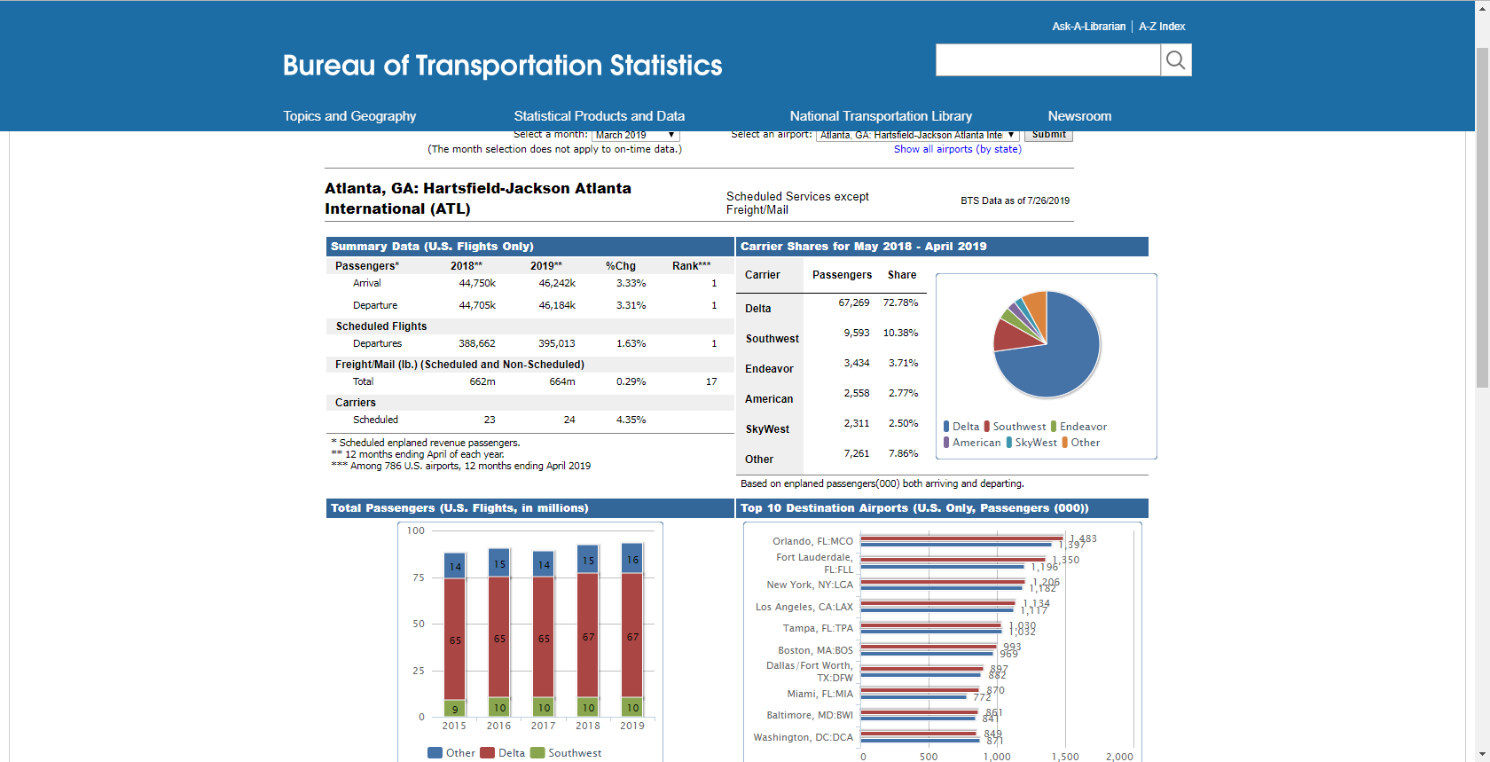
HARTSFIELD-JACKSON INTERNATIONAL AIRPORT (ATL)
Source: https://www.transtats.bts.gov/airports.asp?pn=1

Slide 5
WHAT IS THE QUESTION?
More consumers utilize air travel than before to fly around the world. Record inbound and outbound flights at Hartsfield-Jackson International Airport (ATL) have lead to ATL consistently being named the world's busiest airport. Since the concentration of people is dense at ATL there is potential to study the social and fiscal trends associated with the steady increasing flow of people through checkpoints. Online resources collect various consumer and aviation data that can be organized to illuminate the notion of using flight routes to determine highly populated times and days at ATL.
This research will utilize various data sets that include passenger throughput, maximum number of passengers per flight, aircraft load data, and popular flight routes from Atlanta to predict the population of passengers in the airport. Results from this research determine when ATL is overcrowded through the comparison of passengers enplaning that are traveling to the six most populous flight routes from Atlanta: Fort Lauderdale, FL; Orlando, FL; Tampa, FL; New York, NY; Los Angeles, CA; and Boston, MA.

Slide 6
HOW WE DO IT
Data Wrangling :: Cleaning and Organizing Data for Efficient Use
Exploratory Data Analysis :: After Cleaning, a comprehensive analysis of the data and structure
Statistical Analysis and Data Visualization :: Visual charts, plots, and graphs which allow for statistical inference.
Machine Learning :: Applying regression models to datasets to determine actively “predict” what is happening, mathematically

Slide 7
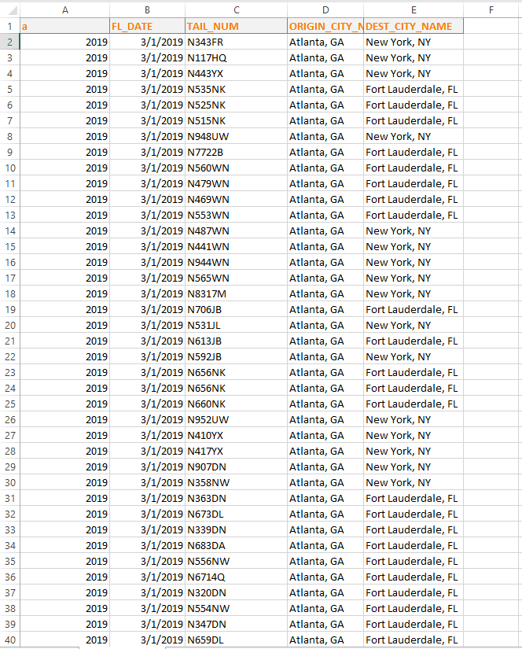
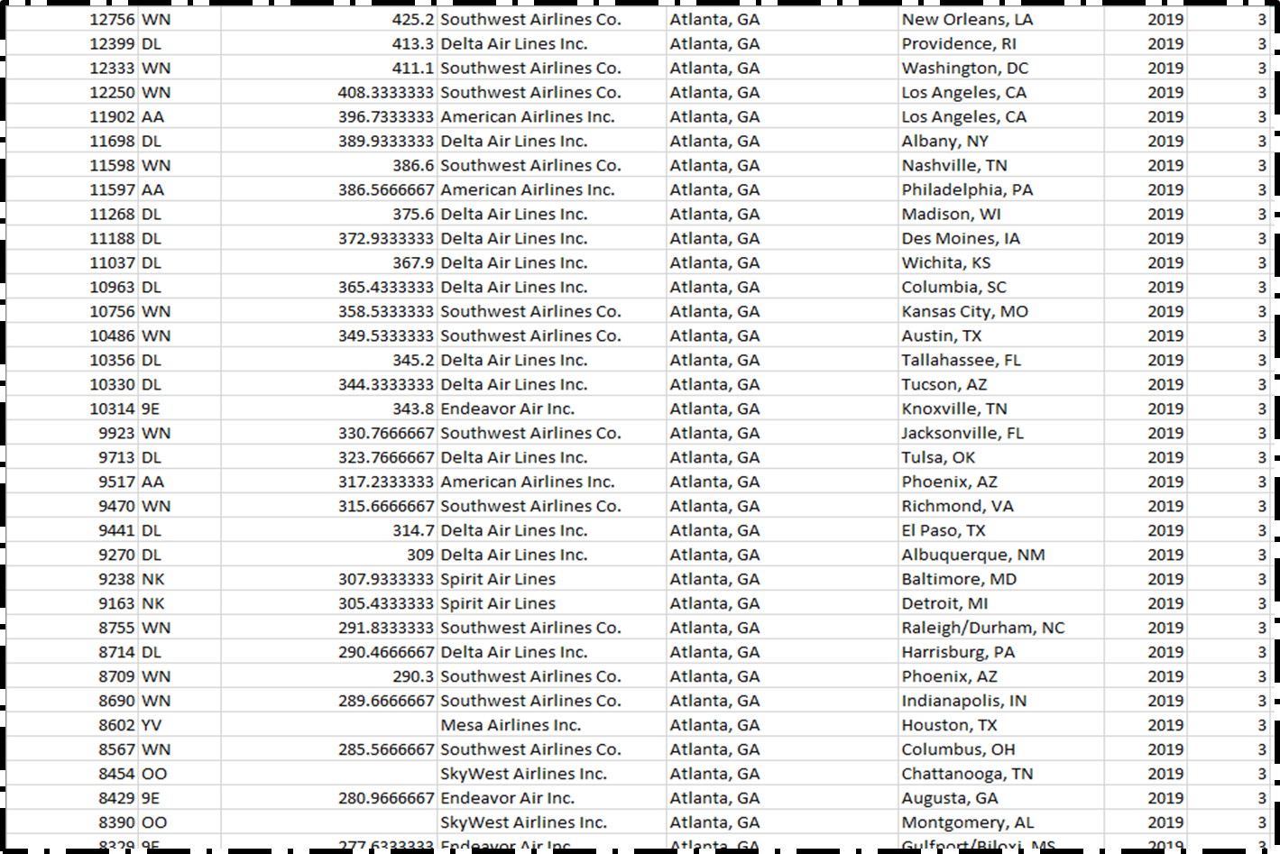
THE DATASETS
To develop a model for predicting the population at Hartsfield-Jackson Airport (ATL) on a particular day, specific information is retrieved and merged from a list of publicly available databases.
Atlanta Routes Database [1]: In this database, the total number of passengers that enplaned in ATL in March 2019 are listed.
BTS Database [2]: This database provides information regarding all flights enplaning at ATL for the month of March in 2019.
[1]
[2]

Slide 8
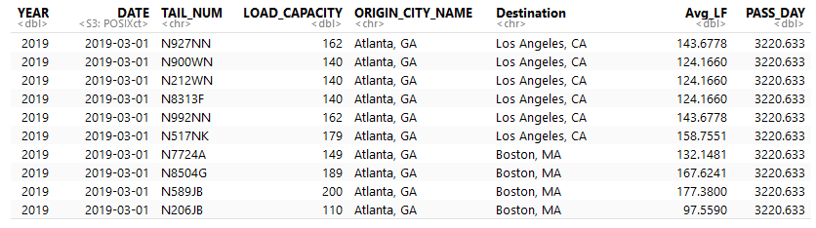
DATA WRANGLING
Cleanliness may be defined to be the emblem of purity of mind.
- Joseph Addison
Looking at the structure (str) of BTS, we see that there are an array of columns removed and added:
YEAR and ORIGIN_CITY_NAME were variables available in both datasets, and thus redundant. The extra set of rows were removed.
Developed a sub-dataset that refines the collection to 6 points, collective, based on the six cities. The load factors of aircraft, averages based on the flights to the six

Slide 9
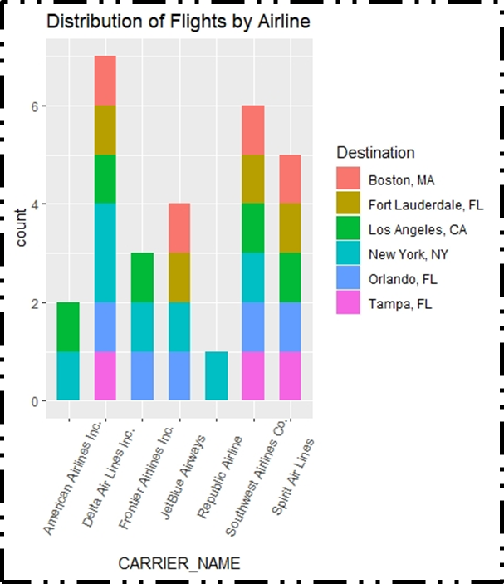
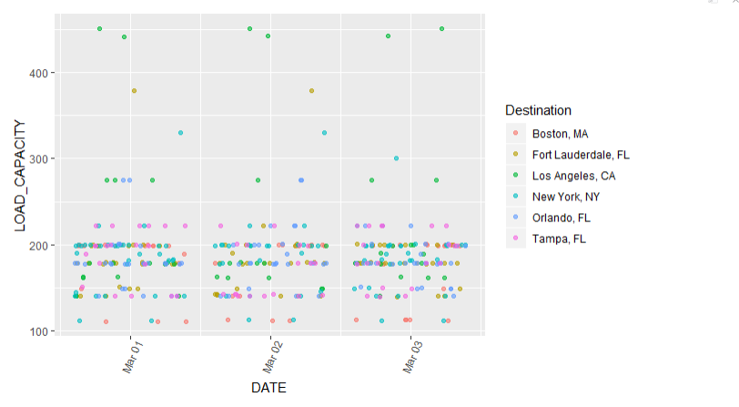
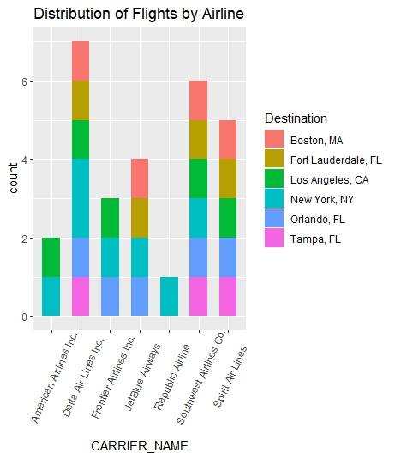
STATISTICAL ANALYSIS
In Figure 3, each dot on the scatter plot represents a flight from the BTS database. passenger population at the airport:
Figure 4 represents the breakdown of flights, Southwest Airlines provide a balanced baseline from having the most flights to these major cities. Further, HJ_ATL is the home hub for Delta and Southwest, making them great data banks for enplaning flights.
[3]
[4]

Slide 10
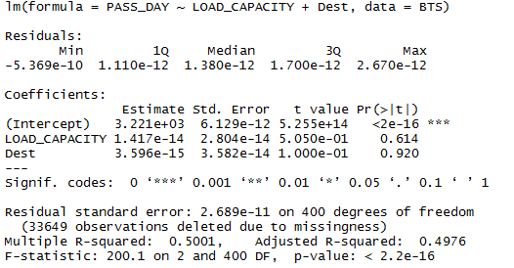
MACHINE LEARNING
In order to provide a more detailed analysis, Machine Learning is incorporated, in which the system conduct analyses based on different regression models or clustering models dictated to it. The exploratory data analysis showed that the number of passengers is related to the number of flights and load capacity available for the given flights.
Performed a linear regression analysis with LOAD_CAPACITY and Dest (Destination) as the independent variables and PASS_DAY as the dependent variable. Dest, when constructed, had a data type of factor, which was be changed to numeric for use in the regression model:

Slide 11
THE ANALYSIS.
1. p-value, which displays the significance of the model compared to a null model, which is usually a model that displays averages of the dependent variable. It is a matter of laying down a baseline for accuracy of the model. The lower the p-value (ranging from 0 to 1), the more likely the model is more accurate at approximation than the null model, and the null model can be thrown out. Because the p-value is less than 0.05 (and even 0.01 for this regression, being 2.2e-16), the null model can be thrown out and it is concluded that this model is more accurate than the baseline.
2. R^2- value, which determines how closeâ the data points are to the regression (or best-fit) line. The values range from 0 to 1, with values closer to 1 indicating that the data points are âcloserâ and more tightly correlated to the regression line. In laymanâs terms, the closer the value is to 1, the better approximation of the data points the predictive model will give. If it is closer to 0, then the independent variable may need to be changed as it does not provide enough context or influence on the dependent variable and is thus not useful for the model.
Here, the R^2 value is 0.5001. This is indicative of the values being moderately close to the line, as 0.5 is evenly between 0 and 1. This alsomeans that there is definitely another more refined choice for the best-fit line. With more testing and incorporating more observations, the results will be closer to the regression line.

Slide 12
FUTURE WORK
In the future, the linear regression model will be expanded to consider additional independent variables.
Also, the expansion of the data points will allow for a more detailed analysis. The point of approximating “congestion” in different systems such as the airport and overcrowding will be considered.

Slide 13
ACKNOWLEDGEMENTS
I would like to acknowledge my Springboard mentor, Dr. Goran Milonavanović, my faculty mentor, Dr. Torina Lewis for their expressed support, and the HBCU-UP Implementation Program.
This research opportunity was sponsored by the National Science Foundation, award numbers 1700408 and 1818682.

